Slide 1
C# 10 | Ultimate Guide Beginner to Advanced

Slide 2
1. Course Fundamentals (Theory)

Slide 3
1.1 Introduction to .NET
.NET is an application development platform to build various applications.
It is the integration of multiple languages (C#, VB, VC++, etc.)
.NET has mainly two modules: C# and ASP
C#.NET: Windows GUI apps, Windows services, and Console applications
ASP.NET: Web sites, Web apps, and Web services

Slide 4
1.2 Common Language Infrastructure (CLI)
The language-neutral language which cant’t be executed by machine
Execution engine of all .NET modules
OS specific machine language
Application Source Code
Compiler
IL
CLR
Native Machine Code
C#.NET / VB.NET
Microsoft Intermediate Language
Common Language Runtime
Executed by OS

Slide 5
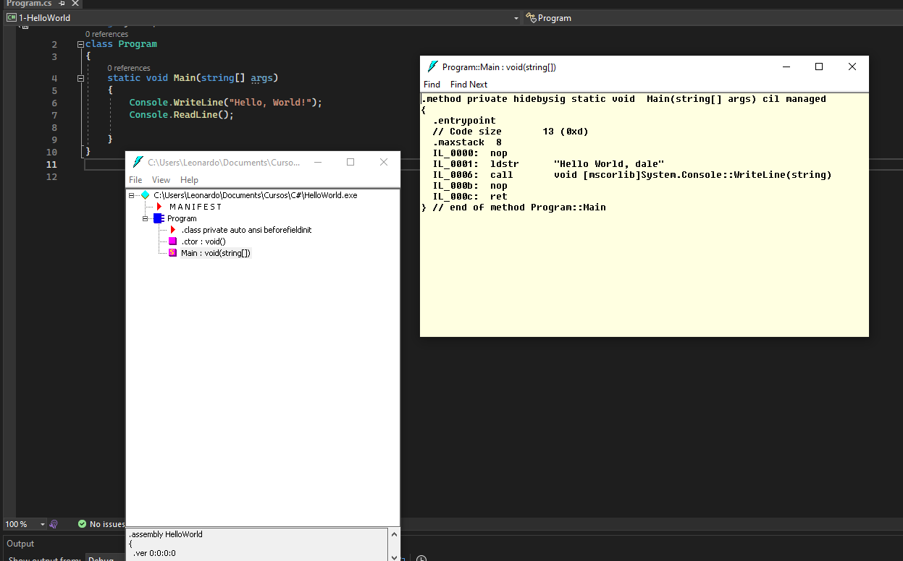
1.2 Common Language Infrastructure (CLI)
Example of IL code
Visual Studio Developer Command Prompt
-> ildasm

Slide 6
1.5 CLR (Common Language Runtime)
CLR is the “execution engine” for all .NET languages
Converts the IL language into nativa machine code and provides several run time services

Slide 7
1.5 CLR (Common Language Runtime)
Class Loader
Loading classes from compiled source code to memory
Loads a class only when it is needed
Memory Manager
Allocating necessary memory for objects
When na object is created in the code, certain amount of memory will be allocated for the object
Garbage Collector
Freeing (deleting) memory of objects
Identifier all unreferenced objects and delete them in memory (RAM)

Slide 8
1.5 CLR (Common Language Runtime)
JIT (Just-In-Time) Compiler:
Convert the MSIL Code into Native Machine Language
Compiles the code of a class, when it is needed (before executing that particular class)
Exception Manager:
Raise notifications while run-time erros
Creates exception logs

Slide 9
1.5 CLR (Common Language Runtime)
Thread Manager:
Create threads (background process) to execute the code
The entire program is treated as “Main thread”
Developer can create sub threads (child threads) to do background processes.
Security Manager:
Verifies whether the app has permission to access system resources or not
Before executing the app, it verifies whether the app has not been attacked by malicious programs & has necessary permissions to access files/folder and hardware resources

Slide 10
1.6 .NET Framework Architecture
C#.NET
VB.NET
VC++.NET
Others
Common Language Specification (CLS)
Win Forms
ASP.NET
WPF
Others
FCL
(Framework Class Library)
ADO.NET
Base Class Library
Common Language Runtime

Slide 11
1.6 .NET Framework Architecture
BCL (Base Class Library)
Contains a set of pre-defined classes that can be used in all types of .NET apps & languages for general I/O operations, type conversion, creation of threads etc.
Ex: Console, String, StringBuilder, Convert, Thread, etc.

Slide 12
1.6 .NET Framework Architecture
ADO.NET
Contains a set of pre-defined classes that can be used in all types of .NET apps & languages for connecting to databases, retrieving data from databases, inserting, updating...
Ex: SqlConnection, SqlCommand, SqlDataAdapter

Slide 13
1.6 .NET Framework Architecture
Win Forms
Contains a set of pre-defined classes that can be used in Windows GUI apps for development of GUI elements such as form, textbox, button, checkbox, etc.
Ex: Form, Label, Button

Slide 14
1.6 .NET Framework Architecture
Windows Presentation Foundation (WPF)
Contains a set of pre-defined classes that can be used in Rich Windows GUI apps for development of GUI elements
Ex: Form, Label, Button
Technically and graphically advanced that Winforms

Slide 15
1.6 .NET Framework Architecture
ASP.NET
Contains a set of pre-defined classes that can be used in web apps for development of GUI elements such as page, textbox, button...

Slide 16
1.6 .NET Framework Architecture
CLS (Common Language Specification)
Contains a set of rules (concepts) that are common to all .NET languages such as C#.NET, VB.NET etc...
Common rules of CLS
CTS (Common Type System): contains data types such as Int32, Int64, Single, Double, etc
Classes & Objects
Reference Variables

Slide 17
1.10 Introduction to C#
C# is a general-purpose programming language by Microsoft introduced in 2002. It is used for development of console apps, Windows GUI apps and Windows services. Use in combination with ASP.NET for web apps, and with Xamarin for mobile apps
Features:
Object Oriented Programming (OOP) Language
Case Sensitive Language
Strongly-Typed Language
Compiler-based Language
Compiled based on CLI (to IL), executed by CLR (JIT)

Slide 18
1.15 C# Naming Conventions
camelCase: for all local variables and parameters
PascalCase: for all class names, structure names, namspace names, field names, method names, property names
IPascalCase: for all interface names
_camelCase: for all private fields

Slide 19
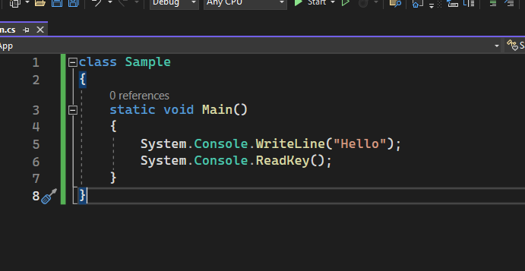
1.17 Creating first C# App
Console class is a part of Base Class Library (BCL) of .NET
namespace
static method
Static methods: able to call methods of a given class without creating a object
class

